Slide 1


Slide 2
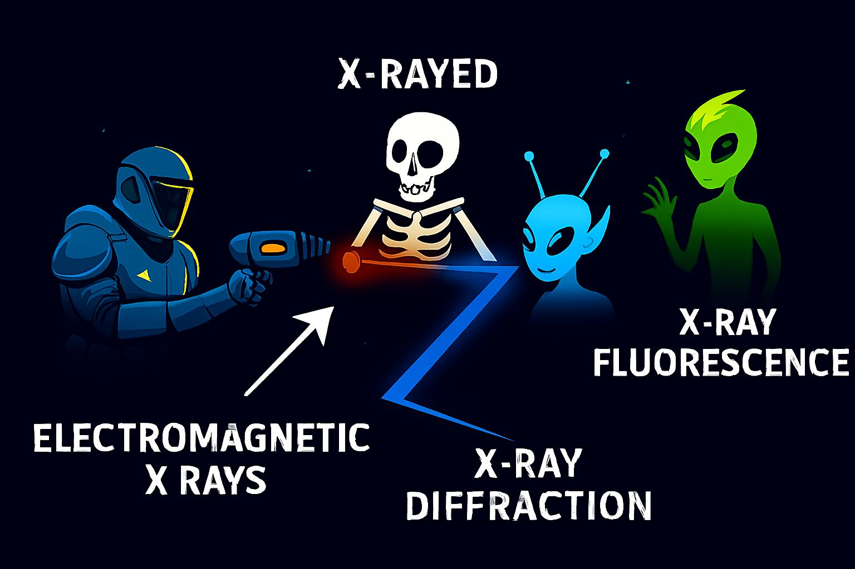

Slide 3


Slide 4
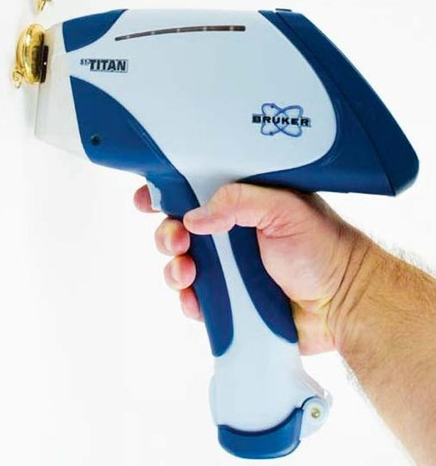

XRF Pros and Cons
Pros
No acids or test tubes
Raw samples can be “zapped”
Portable field instruments (pXRF)
Assays for atoms around 40 instantly and simultaneously
Relatively cheap
Cons
It only assays the surface ~1mm (e.g. rust can affect the reading)
All of the atoms interfere with each other and make the readings drift.
Minor radiation management required

Slide 5

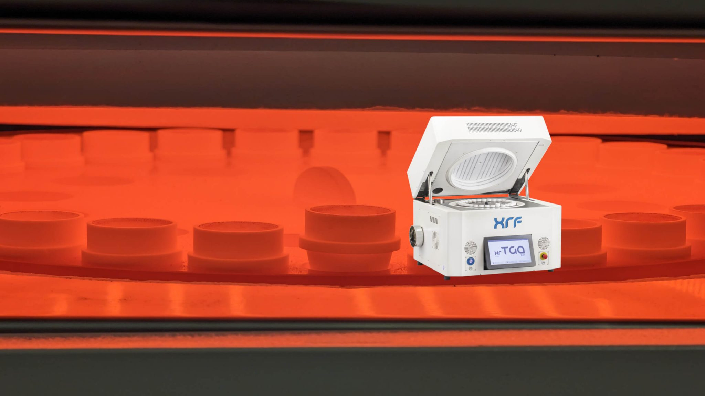
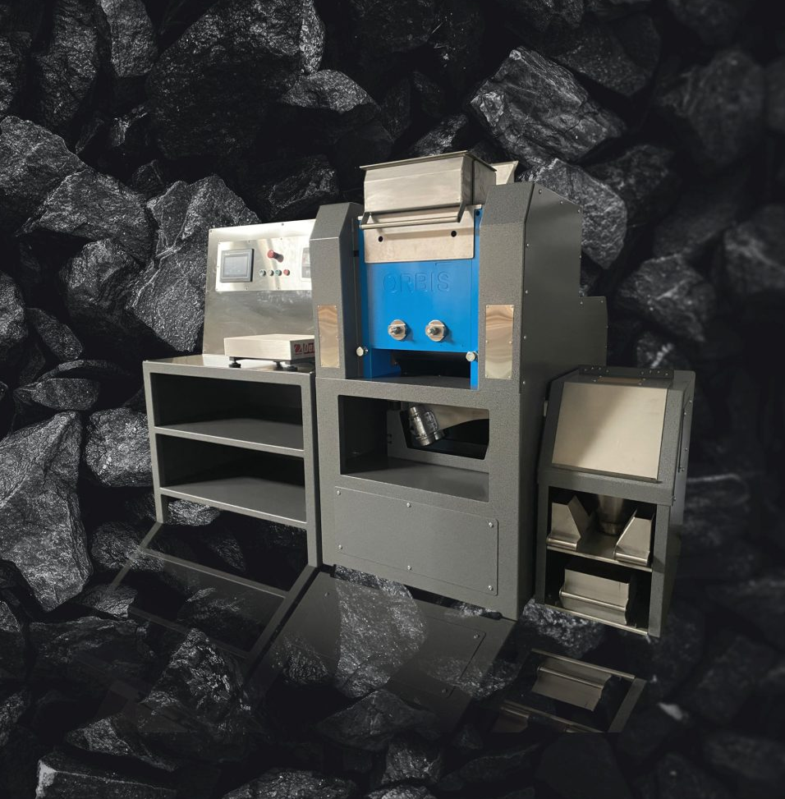
XRF Scientific Application Selection
XRF Scientific developed automated Glass Bead ovens and analysers
Orbis automated Crushers

